Slide 1

Attacking and Defending Active Directory Certificate Services

Slide 2
whoami /all
Jacob Harrand
Senior IT Security Analyst at Rehmann Technology Solutions (Rehmann)
What I do:
Pentesting
GRC
Network and Systems Engineering/Admin
Experience:
2 years of Penetration Testing
5 years of Network and System Engineering/Admin
2 years of .NET Developer/Devops (see above)
2 years of helpdesk

Slide 3
What I will be covering?
Quick level set on Active Directory
What are Active Directory Certificate Services?
Common attacks and where do they come from
How to detect Certificate Services based attacks
How to find these common vulnerabilities and remediate them

Slide 4
Active Directory Refresher
Centralized Authentication & Authorization
Active Directory provides a single point to manage user access to network resources.
Directory Service with Hierarchical Structure
Stores organizational data systematically for easy access and management.
Core Component: AD Domain Services
Enforces security policies and replicates data across the network.
Security & Policy-based Administration
Ensures secure user authentication and simplifies network management through policies.

Slide 5
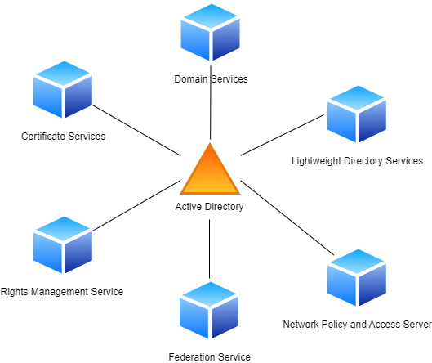
What really is Active Directory?

Slide 6
How Does ADCS fit into Active Directory?
Active Directory can be a large sprawling beast and the different components can blend together into one blob
Certificate Services is an extension of the overarching Active Directory identify provider
What we normally refer to as Active Directory is the component called Active Directory Domain Services

Slide 7
What is Active Directory Certificate Services
The Microsoft Definition: “Active Directory Certificate Services (AD CS) is a Windows Server role for issuing and managing public key infrastructure (PKI) certificates used in secure communication and authentication protocols”
Several Subcomponents:
Certificate Authorities (CA) - Enterprise vs Standalone
Web Enrollment - Web based certificate request
Online Responder - Certificate status information
Network Device Enrollment - Network device certificates
Certificate Enrollment - Policy information
Certificate Templates – Base models of certificates
Notes:
What even is PKI

Slide 8
What is Active Directory Certificate Services Used For
Part of a centralized identity access management
Low cost self-managed PKI
Common Use Cases
Secure Multipurpose Internet Mail Extensions (S/MIME)
VPNs
Smart Card Sign In
Network Access
Digital Signatures
SSL/TLS
Kerberos Authentication Flows

Slide 9
What is a Certificate Template
Functionality of Certificate Templates
Store instructions for creating and submitting valid certificate requests
Control permissions for the templates and enrolling for certificates
The templates are stored in Active Directory for centralized management
Synced from the domain controller
When a user goes to request a certificate from ADCS a certificate template is used to create that certificate

Slide 10
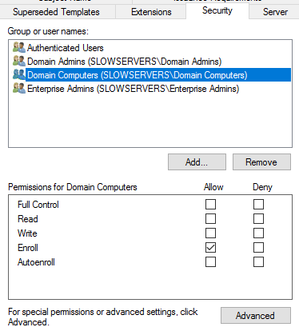
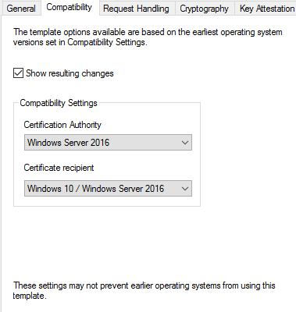
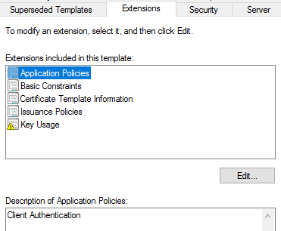
What is a Certificate Template - Cont

Slide 11
What is an EKU?
EKU stands for Extended Key Usage, this defines the purposes of the certificate, effectively restricting what the certificate can be used for in an Active Directory environment
There are defined EKUs in Active Directory:
Any Extended Key Usage – Used for any of the below (having no EKU set is the same thing as any)
Client Authentication – used to authenticate the client, i.e Active Directory
Code Signing – Used to sign executables as trusted
Email Protection – Used to encrypt or sign emails through S/MIME
IPSEC End System/IPSEC Tunnel/IPSEC User – used for IPSEC infrastrcutrue
Key Purpose Client Authentication – Used for PKINIT client authentication
msEFS – Used for the Encrypting File System
Server Authentication – ex: SSL/TLS
Smartcard Logon

Slide 12
Great, what does this all mean?
Active Directory Certificate Service servers are just as critical as domain controllers.
Doubly so if a server is both a domain controller and certificate service server
ADCS exposes the most sensitive parts of Domain Services, accounts and password, in ways that are not highly monitored by default
Web server
Remote Procedure Call (RPC)
Just like a domain controller, certificate service servers that are configured using the add role and features with server manager are setup to be widely compatible, not secure
This means that they are not secure by design
Microsoft signed that secure by design memo from CISA

Slide 13
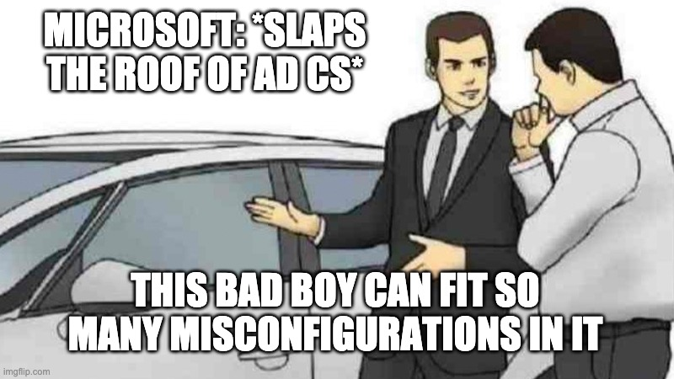
ADCS Issues

Slide 14
Implementation Mistakes of ADCS
Unneeded implementations
Default configuration
Adding more services then are needed
Not knowing your environment
Setting and forgetting
No baseline configuration of certificate templates or certificate authority

Slide 15
Attacking ADCS
Account Persistence
Shadow Credentials
Domain Escalation
ESC Techniques
1-3,9-10 - Certificate Templates
6 - CA
4-5,7 - Access Controls
8 - Web Endpoints
11 –RPC Endpoints
Domain Persistence
Rogue CA certificates
Forging certificates
Creating vulnerabilities
Certificate Theft
CA private key
Code sign certificate
Stored Private Keys

Slide 16
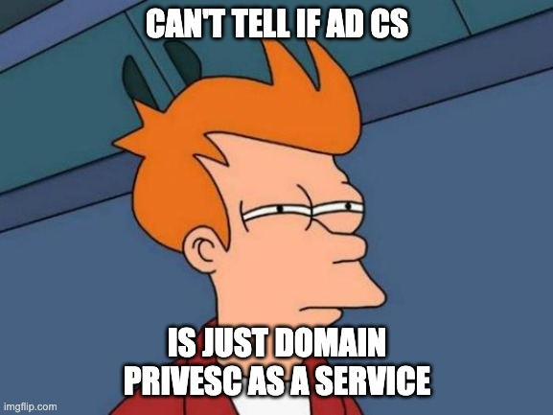
Attacking Active Directory Certificate Services

Slide 17
Domain Escalation
Need initial access
Steal Credentials
Make Credentials
Relay Credentials
Real World Examples
null authentication
LDAP(S) relay
SMB relay
IPv6 mitm

Slide 18
Tooling
Certipy-AD - https://github.com/ly4k/Certipy
Python tool to interact with the various components of ADCS
Impacket - https://github.com/fortra/impacket
Python library and tooling for interacting with Active Directory and Windows
Petitpotam - https://github.com/topotam/PetitPotam
Python tool for coercing authentication

Slide 19
ESC1
Enterprise CA grants low-level users or computers enrollment rights
Manager approval is disabled
No authorized signatures are required
Certificate has the EKU for client authentication
Certificate template allow requesters to specify the subject alternative name

Slide 20
ESC2
Very similar to ESC1
Enterprise CA grants low-level users or computers enrollment rights
Manager approval is disabled
No authorized signatures are required
Certificate template allow requesters to specify the subject alternative name
Differences
Certificate has no EKUs specified or the any purpose EKU

Slide 21
ESC8
Vulnerable/default web enrollment
HTTP
No EPA enabled
NTLM authentication allowed
A certificate that computers or users can enroll for
A certificate that allows for client authentication
Common examples from engagements:
Coerce authentication from a domain joined machine
relay user authentication traffic after gaining man in the middle

Slide 22


Time to Attempt a live Demo
I do have recordings incase I have angered the demo gods

Slide 23

ESC1 Demo

Slide 24

ESC 2 Demo

Slide 25

ESC8 Demo

Slide 26
Now What?
We have the private certificate, how does this help?
How can we use this to pivot through the environment?
impackets
Crackmapexec
Extract ntlm from private key due to client authentication
Extract credentials for the domain controller

Slide 27
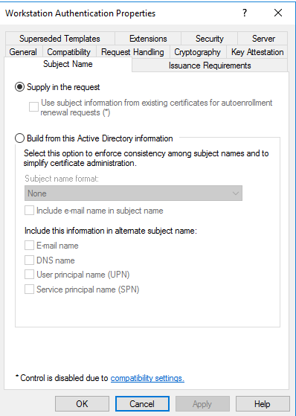
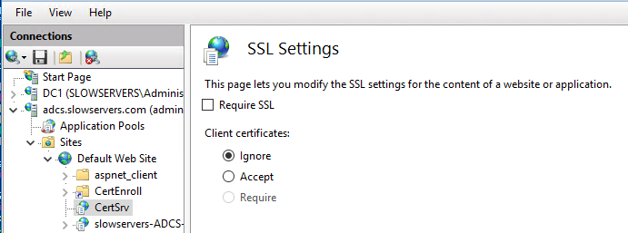
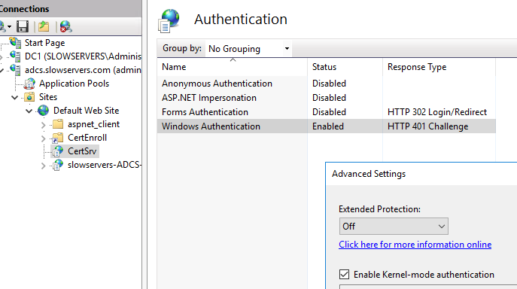
How Are the vulnerabilities?

Slide 28
Investigating possible ADCS attacks
Disclaimer: If you believe there is an active threat in your production environment please follow your corporate policy in responding
Requires proper logging to be enabled, without it we are blind

Slide 29
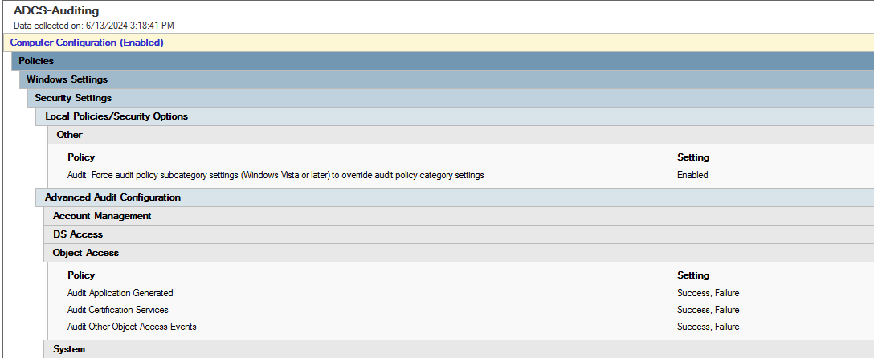
How to Log ADCS - GPO

Slide 30
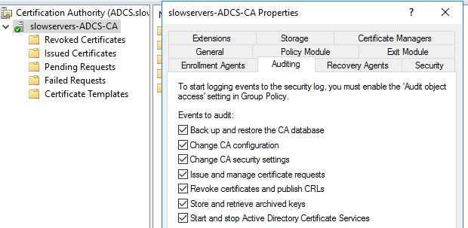
How to LOG ADCS – CA

Slide 31
What are Sigma Rules
From the book definition: “A Sigma rule is an open-source, generic signature format used in cybersecurity, specifically for the creation and sharing of detection methods across Security Information and Event Management (SIEM) systems”
Created by Florian Roth and Thomas Patzke in 2017
Use YAML for definition
Like YARA rules use indicators of compromise Sigma uses match criteria
Allows for standardization across tooling due to the generic signature

Slide 32
Sigma Rule Fields
Title
Status, like experimental or tested
Description of what it detects
Author name
Date
ID
License, assuming the author shares the rule
Level
Data or log source
Set of conditions
Tag, including MITRE ATT&CK mapping

Slide 33
Sigma Data Sources
Made up of:
Product
Category
Service
We will be focusing on the product of windows
Can detect most audit events for windows
We are focusing on are:
Certificate Services

Slide 34
Creating AD CS sigma rules
Disclaimer: I am not a sigma master
I found out that not all sigma implemenations are created equal
Hence why I have marked my rules as experimental
I will be using Hayabusa to run my sigma detections locally
https://github.com/Yamato-Security/hayabusa

Slide 35
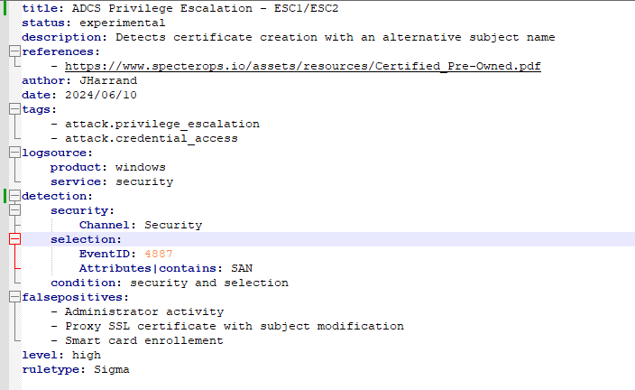
Detecting ESC1/ESC2
Detects both ESC1 and ESC2 as it is looking for anything that is setting a alternative subject name

Slide 36

Sigma Demo

Slide 37

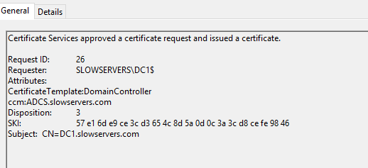
How about ESC8?
With ESC8 we can’t use sigma rules as they can not correlate across multiple data sources
We would need to know the IP of the connection, the targeted asset (assuming it’s a machine), and the template requested

Slide 38
Defending ADCS
Microsoft Defender for Identity
Crowdstrike Identity Protection
Proactive review and mitigation of your enviroment
https://github.com/TrimarcJake/Locksmith
Locksmith allows for a quick audit of your ADCS enviroment
I don’t recommend the automatic fix mode – I have seen it break stuff

Slide 39
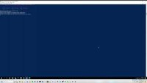
LockSmith Demo

Slide 40
Remediate and Mitigate ESC1 and ESC2
Set the subject to build from Active Directory Information
If that cant be done, then:
Restrict access to the roles who truly needed it
Add manager approval
Add authorized signers
Change what the purpose (EKUs) of the certificate are
Disable unneeded certificate templates
ESC2 only:
Specific the purpose on the certificate

Slide 41
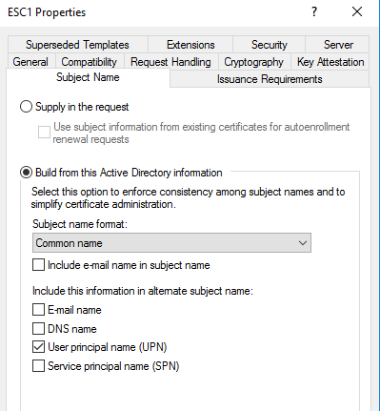
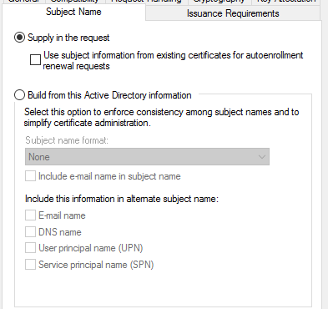
Remediate ESC1
Set the subject name to be build from Active Directory Information

Slide 42
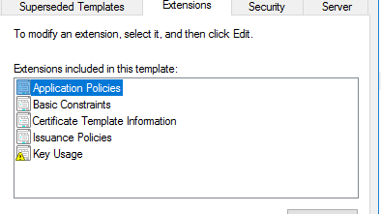
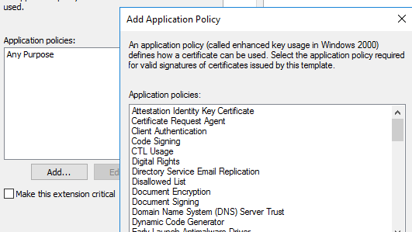
Remediate ESC2
In addition to the changes for ESC1, apply a specific Application Policy/EKU for the template

Slide 43
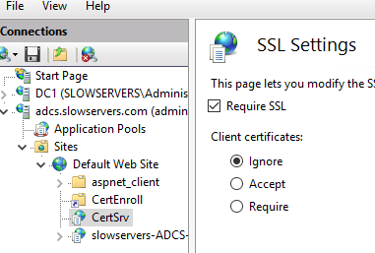
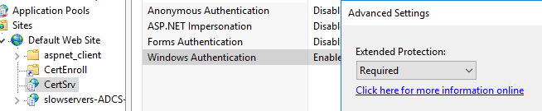
Remediate and Mitigate ESC8
Enable HTTPS only, disable the usage of HTTP
Enable EPA
Microsoft recommends to enable kerberos only authentication
Be aware this will most likely break things in your enviroment

Slide 44
Labing
Github repo: https://github.com/Orange-Cyberdefense/GOAD/tree/main?tab=readme-ov-file
Sigma rule example and powerpoint: https://github.com/denchief1/adcs-talk

Slide 45
Questions?

